Slide 1
Student Placement Tracker
PlacementHub – A NoSQL Database Project
Team Members: Pavani, Suma, Anusha Madari
NoSQL Database Course | October 2026
Notes:
PRESENTER: Pavani. Introduce the team and the project. Pavani starts, Suma covers the database, Anusha covers backend, CRUD operations, integration and testing.

Slide 2
What is the Project?
The Problem
Our Solution
Placement details live in spreadsheets and notes – hard to track applications, interviews, offers and deadlines.
PlacementHub – one web app that keeps every placement record together, stored in DynamoDB.
Six modules
Dashboard
Students
Applications
Interviews
Offers
Tasks
Counts and stages
Profiles
Company, role, status
Date, type, notes
Salary, decision
Priority, due date
Student Placement Tracker | NoSQL Database Project
Notes:
PRESENTER: Pavani. Explain the problem and our solution, then the six modules.

Slide 3
Technologies Used
Language
Frontend
Backend
JavaScript, JSX, CSS
React 18 · Vite · React Router
Node.js · Express.js REST API
Database
Database driver
Tools
Amazon DynamoDB Local (NoSQL)
AWS SDK for JavaScript v3
Docker · VS Code · Git · GitHub
Student Placement Tracker | NoSQL Database Project
Notes:
PRESENTER: Pavani. Go through each card: language, frontend, backend, database, driver and tools.

Slide 4
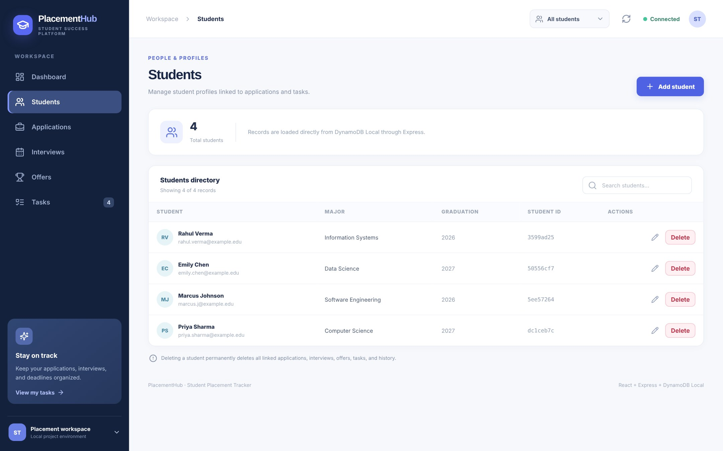
Project Demonstration
1
Dashboard with live counts
● LIVE DEMO
2
Filter by student
3
Search and filter applications
4
Add a new application
5
Refresh – data still saved
6
Add an interview – status updates
We switch to the running app now
Student Placement Tracker | NoSQL Database Project
Notes:
PRESENTER: Pavani. Switch to the browser and run the live demo. Slides 5 and 6 are backup if the demo fails.

Slide 5
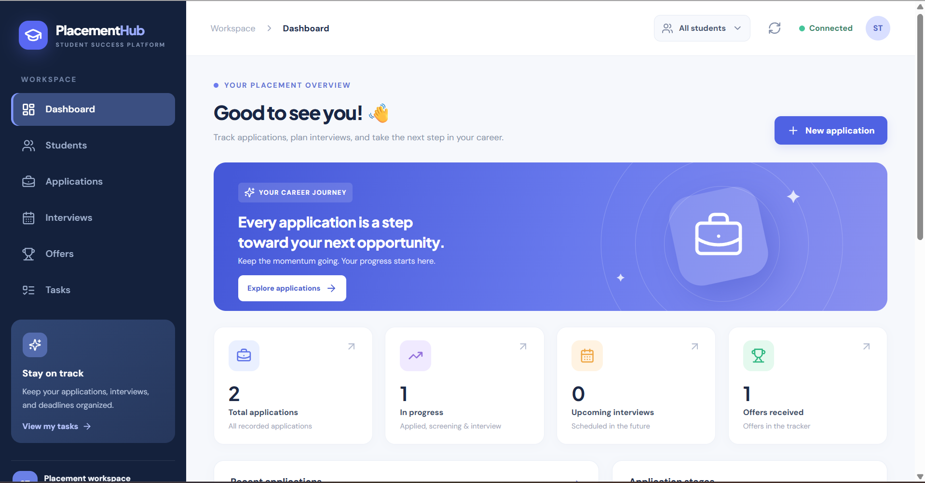
Demo – Dashboard
1
Summary cards
Applications, in progress, interviews, offers
2
Application stages
How many applications are at each stage
3
Student filter
Show one student or all students
Student Placement Tracker | NoSQL Database Project
Notes:
PRESENTER: Pavani. Backup: point to the numbered markers on the screenshot.

Slide 6
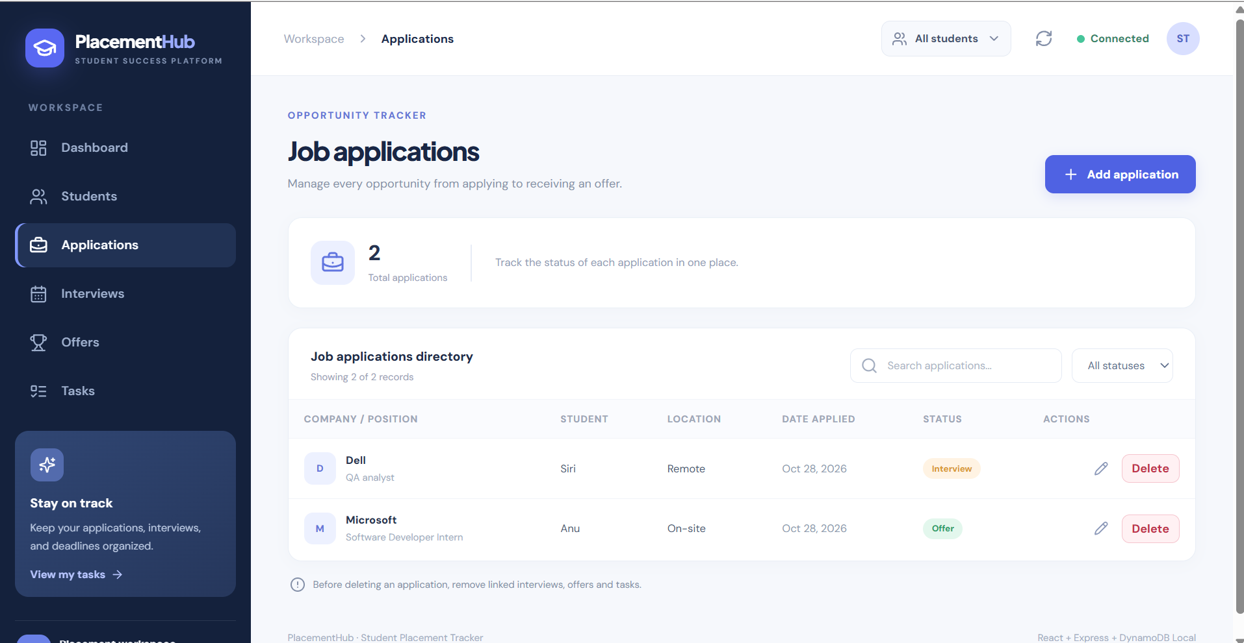
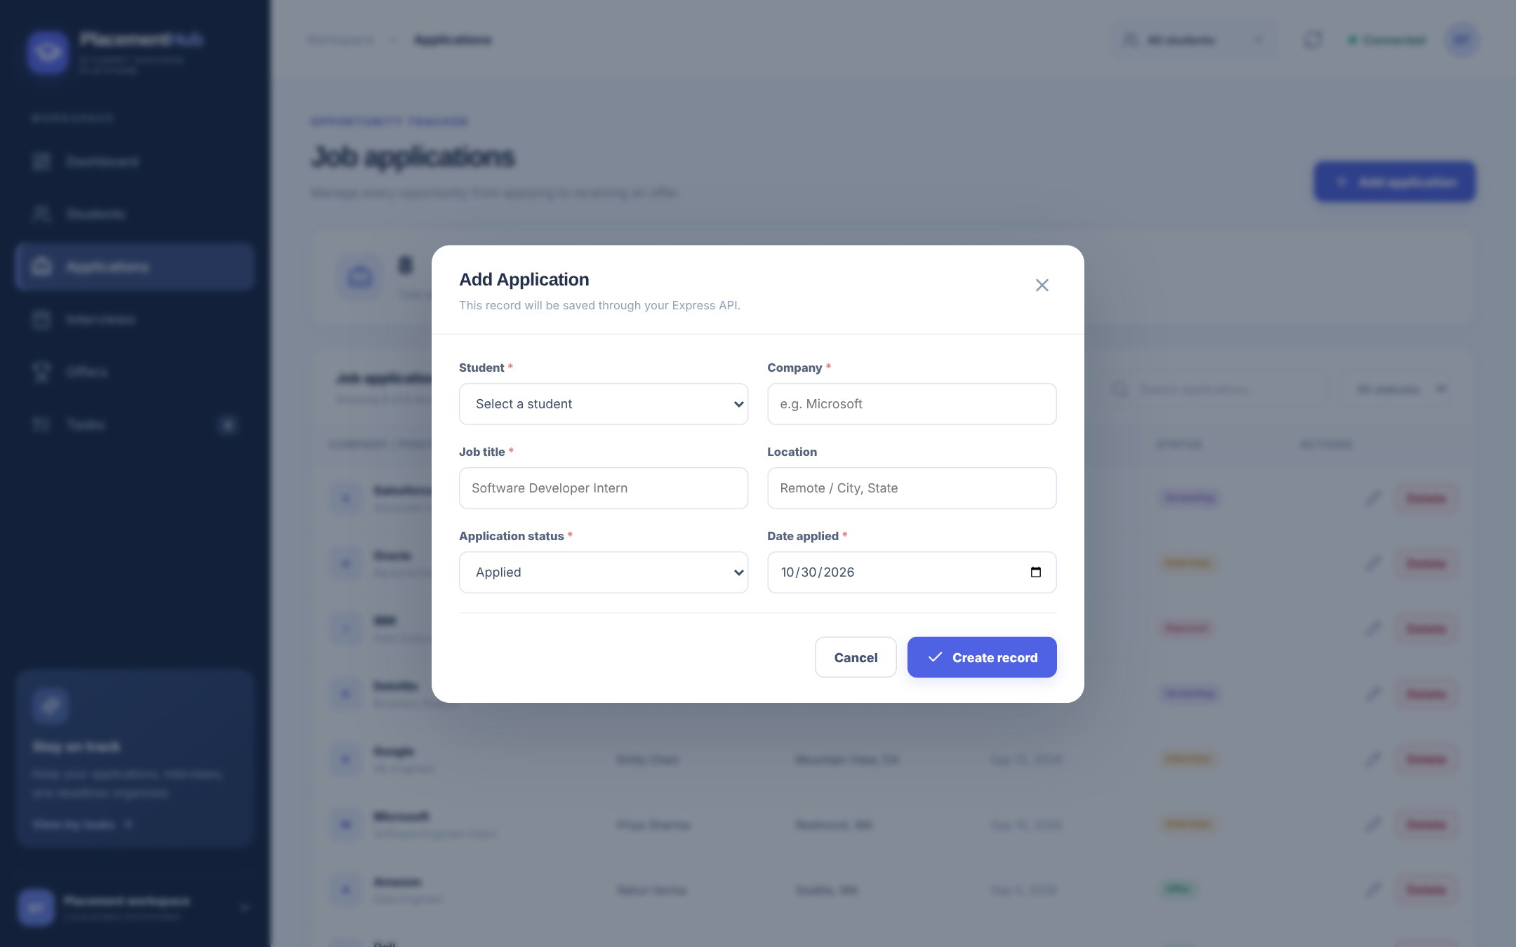
Demo – Applications Page
Every page:
List
Search
Add
Edit
Delete
Student Placement Tracker | NoSQL Database Project
Notes:
PRESENTER: Pavani. Backup screenshots. Students, Interviews, Offers and Tasks work the same way.

Slide 7
NoSQL Database – Amazon DynamoDB
6
6
0
JSON
Tables
Indexes (GSI)
Joins
Documents
Table | Primary key | Index (GSI)
Students | studentId | –
JobApplications | applicationId | studentId-index
Interviews | interviewId | applicationId-index
Offers | offerId | applicationId-index
Tasks | taskId | studentId-index, applicationId-index
ApplicationActivity | activityId | applicationId-index
Student Placement Tracker | NoSQL Database Project
Notes:
PRESENTER: Suma. Six tables, each with one partition key. No joins: parent IDs are stored on child items, with a GSI on them.

Slide 8
How Data is Stored
One application record (JSON document)
Student
Tasks
applicationId
18e9e67e-…
studentId
dc1ceb7c-… (link to student)
Job Application
company
Amazon
jobTitle
Data Engineer
Interviews
Offers
History
location
Seattle, WA
status
Offer
Children store the parent's ID (studentId / applicationId) – no foreign keys.
appliedDate
2026-09-05
Student Placement Tracker | NoSQL Database Project
Notes:
PRESENTER: Suma. Show a real JSON item, then how records connect through IDs.

Slide 9
How We Installed the Database
1. Install Docker
2. Compose file
3. Start
4. Create tables
Docker Desktop
dynamodb-local image, port 8002
docker compose up -d
node create-tables.js
Docker setup (docker-compose.yml)
Result: all 6 tables created
Image
amazon/dynamodb-local
Students
JobApplications
Container
student-placement-db
Interviews
Offers
Port
8002 on PC → 8000 in container
Storage
Named volume – data is kept
Tasks
ApplicationActivity
Student Placement Tracker | NoSQL Database Project
Notes:
PRESENTER: Suma. No AWS account needed. Port 8002 on our PC maps to 8000 in the container. Named volume keeps data.

Slide 10
System Architecture
Frontend
Backend
Database
React + Vite
HTTP
JSON
Node.js + Express
AWS
SDK v3
DynamoDB Local (Docker)
localhost:5173
localhost:5000/api
localhost:8002
Safe
Organized
Free to run
Browser never touches the database
All DB code lives in backend services
Local DynamoDB – no cloud cost
Student Placement Tracker | NoSQL Database Project
Notes:
PRESENTER: Anusha. Three tiers, left to right, and three reasons for this design.

Slide 11
How We Integrated the Database
Database connection (db.js)
Every request follows the same path:
Library
AWS SDK for JavaScript v3
Route
/api/students
Endpoint
localhost:8002
Controller
checks input · status code
Region
us-east-1
Service
sends DynamoDB command
Credentials
Local placeholders only
Client
DocumentClient (plain JS objects)
DynamoDB
stores the JSON item
Used by
Every backend service
Settings come from a .env file – only local placeholder keys, no real AWS secrets.
Student Placement Tracker | NoSQL Database Project
Notes:
PRESENTER: Anusha. One shared client used by every service; route → controller → service → DynamoDB.

Slide 12
Database Operations Implemented
C
R
U
D
Create
Read
Update
Delete
PutCommand
GetCommand · ScanCommand
PutCommand · UpdateCommand
DeleteCommand
Query
Transaction
Admin
QueryCommand on GSI indexes
TransactWriteCommand – all or nothing
CreateTable · DescribeTable · ListTables
Student Placement Tracker | NoSQL Database Project
Notes:
PRESENTER: Anusha. I implemented full CRUD, plus GSI queries, transactions and table administration.

Slide 13
Workflow and Business Rules
Create student
Add application
Schedule interview
Receive offer
Record decision
New interview
New / updated offer
1
2
Application moves to Interview
Application moves to Offer
Offer declined
Any status change
3
4
Offer = Declined, application stays at Offer
Saved in ApplicationActivity (history)
Student Placement Tracker | NoSQL Database Project
Notes:
PRESENTER: Anusha. Example: a Dell QA Analyst application moves Applied → Interview → Offer automatically.

Slide 14
Deleting a Student Safely (Transaction)
1. Confirm
2. Collect
3. Check
4. Commit
?confirm=DELETE required
Applications, interviews, offers, tasks, history
Over 100 records → stop, delete nothing
One TransactWriteCommand
Deleted together in one transaction
100
Student
Applications
max records in one transaction
Interviews
Offers
All or nothing –
no orphan records
Tasks
History
Student Placement Tracker | NoSQL Database Project
Notes:
PRESENTER: Anusha. NoSQL has no ON DELETE CASCADE, so studentService.deleteStudent does it in one transaction.

Slide 15
Testing
Create / edit a student
Schedule an interview
Data stays after refresh
Application moves to Interview
6 / 6
Create / decline an offer
Complete a task
tests passed
Stage = Offer, decision = Declined
Dashboard counts update
Tested by hand through the UI, PowerShell API calls and browser DevTools
Delete student + linked records
Restart server, refresh
Everything linked is removed
Records still in DynamoDB
Student Placement Tracker | NoSQL Database Project
Notes:
PRESENTER: Anusha. Manual end-to-end tests; destructive tests only on temporary records.

Slide 16
Team Contributions
P
S
A
Pavani
Suma
Anusha Madari
Frontend
Database
Backend, CRUD, Integration & Testing
React pages and dashboard
Forms, search, filters
Routing and styling
DynamoDB Local in Docker
Table and index design
Database setup and checks
Express REST API + CRUD
AWS SDK integration, rules
Cascade delete, testing
Student Placement Tracker | NoSQL Database Project
Notes:
PRESENTER: All three. Each person says one or two lines about their own part: Pavani, then Suma, then Anusha.

Slide 17
Thank You!
Questions?
Notes:
PRESENTER: Anusha (moderates Q&A). Summarize what we learned, then take questions and pass each to the owner of that area.

